Slide 1

Drafting of Will and Succession of Property
CA Farhad G Wadia
JHS Consulting
www.jhsconsulting.in. farhad.wadia@jhsconsulting.in
This Presentation is for private circulation and not for publication or circulation.

Slide 2
Preface
Jar, Javerat, Jooru = Property Curse!
True or False?
Death is certain and with it comes the pain and animosity from Property among loved ones
Happy learning!

Slide 3
Overview
Who is Hindu?
What is Will?
Who can make Will?
Properties Covered by Will
Procedural Requirements
Witnesses
Drafting Will
Joint and Mutual Will
Executor / Administrator
Will as Trust Deed
Modification / Revocation
Procedure after Death
Advance Medical Directives

Slide 4
1. Why make a Will?
Property is shared based on your decision.
Prohibit family disputes and reveals all assets.
Security & Protect your Business.
Foreign settled children can receive legacy through executors of will created by parents living in India.
If a person die without executing a Will (intestate), inheritance laws usually divide in equal share to the surviving spouse and children even though the assets were jointly earned by husband and wife.
There may be cases where both the parents may die in some tragic accident. If in such circumstances, no guardian has been appointed, the court may appoint one who would not be your first choice.

Slide 5
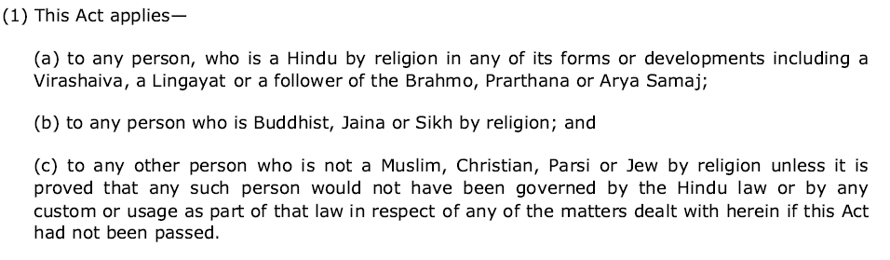
1. Who is Hindu?
Section 2 of The Hindu Succession Act, 1956 defines Hindu as follows:
Who is not a Hindu?
Christians, Buddhist, Parsi, Jew by religion are covered by Indian Succession Act 1956.
Each of these religion have been given exceptions for accommodating particular cultural and religious values.
Muslim are covered by “Hanifa Law” which is part of Muslim Personal Law.

Slide 6
2. What is a Will
Legal Declaration
Statement of Intention of Testator
With respect to testator’s property
Desires to be carried into effect after testator’s death
Some Relevant Terms
Intestate Succession / Testamentary Succession
Codicil
Probate / Letter of Administration

Slide 7
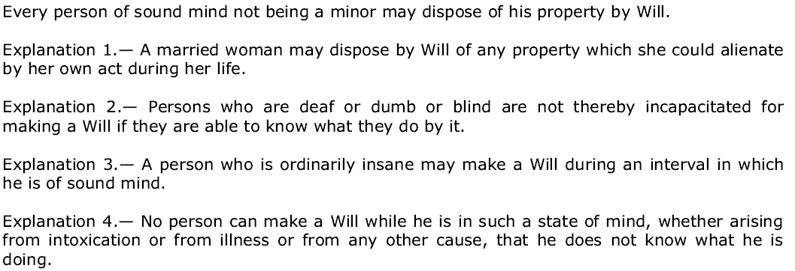
3. Who can make a Will
Not a minor (>18 years)
Of sound mind

Slide 8
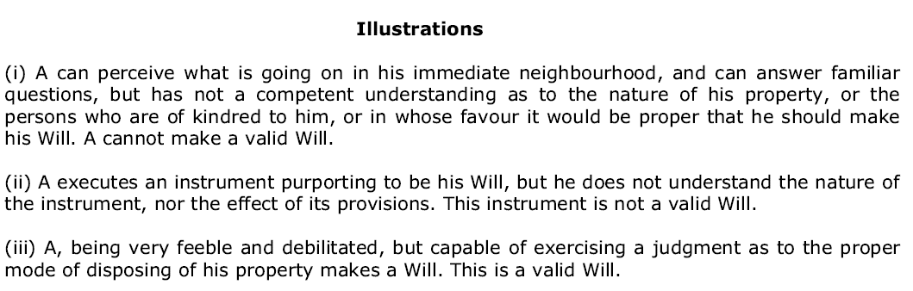
3. Who can make a Will (Continued)

Slide 9
4. Properties Covered by Will
One can only give away what one has.
Ownership or other rights on the date of death relevant.
Immovable properties governed by law of land.
Movable properties governed by law of domicile.
If one has immovable properties outside India, Will as per law where properties are located.
A Will as per Indian law can be made anywhere in the world.

Slide 10
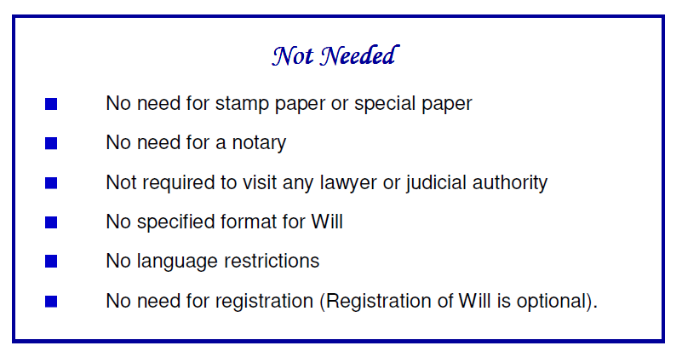
5. Procedural Requirements

Slide 11
5. Procedural Requirements (Continued)
Must be in writing.
Signed by testator in the presence of witnesses.
Signed by the witnesses in the presence of testator.
Attesting witnesses must sign in capacity of witnesses.
A personal acknowledgment by the testator of witnesses.
Advised that each page be signed by the testator as well as the witnesses.

Slide 12
5. Procedural Requirements (Continued)
Any overwriting in Will must be signed by testator as well as witnesses.
Safekeeping of the Will – Multiple copies advised kept with different persons (beneficiaries) .
Registration – Optional. Recommended when Will is not being disclosed to legatees. Registration prevents keeper of Will from committing forgery.
Fraud or coercion makes a Will null and void.
Flattery or taking care of testator does not affect the Will’s legal status.

Slide 13
6. Witnesses to Will
Beneficiary can be a witness. But strongly advise against it.
Witness must NOT be of doubtful integrity or character.
Witness should preferably be literate and be able to stand cross-examination by aggressive lawyers.
Person named as executor can be witness. But advised that it be avoided.
A corrupt witness can undo a Will after the death of testator.

Slide 14
7. Drafting of Will
No prescribed format
Language should be the one that testator is comfortable with
Must be simple and easy to understand
Avoid legalese – no legal terms; no reference to laws
Must convey intentions of the testator in clear terms
Should be specific
General preaching and philosophical thoughts to be avoided
Must not be ambiguous in any way
A person with no knowledge of law should be able to understand and interpret it.

Slide 15
7. Drafting of Will (Continued)
Date – Not a legal necessity, but highly recommended. Should appear at only one place in the document.
Description of Testator – Name, father’s name, address, approximate age should be written. Preferable to mention religion, domicile (for NRI’s), PAN / AADHAAR / Passport No.
Description of Properties – Can either be general like “all my bank accounts” or be specific. For immovable properties detailed description giving address, size etc. advised. In case testator has partial or limited rights, same be mentioned.
Description of Beneficiaries / Legatees – Identify by name as well as relationship. May also provide other details like father’s name, approximate age, address, and some identification number.

Slide 16
7. Drafting of Will (Continued)
Numbering of Paragraphs – Not a legal requirement, but advised for clarity.
Revocation of Previous Wills – Mention of all previous Wills is highly recommended. Advised that all previous Wills are revoked and the new Will is a comprehensive document.
Denial of Benefit to Natural Heirs – If Will denies benefits to natural heirs, it is advised that reasons for denial are mentioned.
Bequest for Charity or Religious Purposes – Allowed to Hindus.
Bequest to Minor Children – Allowed.
Residuary Legatee – Recommended that there be a legatee who gets what no one else gets.

Slide 17
8. Joint and Mutual Will
Law in India does not recognize husband and wife as joint owners of all properties acquired after marriage.
If either of husband / wife dies intestate, property of deceased is divided equally among the survivor and children of the couple. This can often lead to much distress and pain for survivor in old age. For example, it may lead to displacement from family home or may lead to dissipation of pension deposits intended for old age.
A Joint and Mutual Will gives all properties of the deceased to the survivor.
It may provide for distribution of properties after death of both husband and wife.

Slide 18
9. Executor / Administrator
Executor is appointed by the testator in Will.
Administrator is appointed by competent authority.
Any person (including beneficiary) can be named as executor.
Executor need not be legal professional or have knowledge of law.
Executor represents deceased and holds all powers of deceased.
Not compulsory to appoint executor.
A dishonest / rogue executor can be a big nuisance.
When no executor is named in Will, beneficiaries can apply for Letter of Administration or can get conveyance without court intervention.

Slide 19
10. Will as Trust Deed
Private Trust is created for the benefit of specific beneficiaries. Public Trust is for undefined beneficiaries or charity or religious purposes.
Private Trust can be created using Will only using movable properties. Immovable properties cannot be transferred to Trust using Will.
Private Trust typically created when beneficiaries are incapable of managing their affairs like in case of physically or mentally challenged persons; also used for children; abroad common to use private trusts for pets.

Slide 20
10. Will as Trust Deed (Continued)
Intention to create Trust should be clearly mentioned.
Purpose of the Trust should be clearly stated.
Beneficiaries should be clearly named.
Movable property being moved to Trust should be clearly defined and there should be no confusion or uncertainty around it.
Trustee(s) should be clearly named and / or the process of appointing trustee(s) should be clearly specified.
Directions for dissolution of private trust and distribution among beneficiaries should be clearly stated.

Slide 21
11. Modification / Revocation
A Will can be modified / revoked anytime during lifetime of testator.
Modification / revocation to be done same way as execution. Sound mind + Two attesting witnesses.
Modification by overwriting after execution not allowed.
Revocation by burning or tearing of Will allowed but burning or tearing must be in front of two witnesses.
Witnesses required for modification / revocation. Same witnesses as for original Will not required.
Modification / revocation of registered Will need not be registered, but advisable.

Slide 22
12. Procedure after death of testator
Probate / Letter of Administration is almost compulsory in Mumbai and Chennai, but mostly not required in rest of India.
In most parts of India, a notarized true copy (in some places a photocopy) of Will and Death Certificate of testator sufficient to get conveyance of property in favour of legatee.
Application for probate by Executor.
Application for Letter of Administration by a beneficiary if there is no executor named in the Will.
Probate / Letter of Administration granted by appropriate court.

Slide 23
13. Advance Medical Directives
  Advance Medical Directives (AMD) / Living Will are directions to one’s near and dear ones to take critical decisions during:
  A terminal condition – an incurable or irreversible condition which even with the administration of life-sustaining treatment will result in death in foreseeable future.
  A persistently unconscious condition – an irreversible condition, in which thought and awareness of self and environment are absent.
  An end-stage condition – a condition caused by injury, disease or illness which results in severe and permanent deterioration indicated by incompetency and complete physical dependency for which treatment of the irreversible condition would be medically ineffective.

Slide 24
13. Advance Medical Directives (Continued)
  Essential Concepts:
  AMD and Will are very different; cannot be combined. AMD relates to before death. Will relates to after death.
  Active Euthanasia – some action like injecting a poison is absolutely illegal. AMD does not relate to active euthanasia.
  Passive Euthanasia – not providing some life saving treatment or withholding or withdrawing life support systems. Allowed subject to safeguards.
  Medical Power of Attorney – Also called guardian / caretaker / trusted agent. To take critical healthcare decisions when one is not able to take such decisions.

Slide 25
13. Advance Medical Directives (Continued)
  Execution of AMD:
  Only adult can execute & Must be of sound mind
  Voluntarily executed without fraud or coercion & Must be in writing
  Must lay down in clear terms (a) when medical treatment may be withdrawn and (b) when specific medical treatment shall not be given.
  Giving Effect to AMD – Four stage protection:
  Guardian or caretaker named in the AMD
  Doctor treating the patient &
  Medical Board constituted by the hospital
  Medical Board constituted by the District Collector.

Slide 26
13. Advance Medical Directives (Continued)
  Procedure for execution of AMD:
  Like Will to be signed in front of two or more witnesses.
  To be countersigned by Judicial Magistrate of First Class (JMFC).
  Copies to be given to JMFC, family members, district court, family physician, local government (municipal corporation / panchayat).
  No stamp duty required.
  No particular format prescribed.
  No registration / fees.
  However in India the Doctor has the final discretion and AMD is a guide.

Slide 27
16. Income Tax Implication
  Transactions not regarded as transfer [Section 47]
  The meaning of transfer is given in section 2(47), whereas transactions not regarded as transfer are covered under sections 46 and 47. In the following transactions although there is a transfer, these are not considered to be transfer for purposes of capital gains:—
  (iii) any transfer of a capital asset under a gift or will or an irrevocable trust.
  Deemed cost of acquisition Cost to the previous owner [Section 49(1)]:
  Where the capital asset became the property of the assessee in any of the manner mentioned below, the cost of acquisition of the asset shall be deemed to be cost for which the previous owner of the property acquired it: (a) on the distribution of the assets on total/partial partition of Hindu Undivided Family; (b) under a gift or will; (c) by succession, inheritance or devolution;
  Income of any person to include gift of money etc.
  Section 56(2)(x), shall not apply to any sum of money or any property received— (i) from any relative; or (ii) ….. (iii) under a will or by way of inheritance; or (iv) ……

Slide 28
16. Income Tax Implication
  Private discretionary trusts:
  Private discretionary trusts created through a Will.
  Where trust income includes business income also [Section 161(1A)]
  Where the income of the beneficiary in the hands of trustee being representative Assessee consists of or includes profits and gains of business, tax shall be charged on the whole of the income in respect of which such person is so liable at the maximum marginal rate.
  However the maximum marginal rate in the above case shall not be chargeable if such profits and gains are receivable under a trust declared by any person by will exclusive for the benefit of any relative dependent on him for support and maintenance and such trust is the only trust so declared by him.
  Public Trusts:
  Public Trusts can be created out of will for religious or charitable purposes.
  Charitable trust can also enjoy tax benefits.

Slide 29
17. Income Tax Implication
Who is an executor or administrator?
  An executor is a person who is appointed by the testator to carry out and execute his wishes and for that purpose, to administer his estate after his death.
  An administrator is a person who is not appointed by the testator, but who is granted letters of administration by a court to the administer the estate.
  The capacity of the executors to represent the estate is derived under the will from the date of death and does not depend on whether he has obtained probate or not.
How is the income chargeable in the hands of the executor? [Section 168(1)]?
  Subject as hereinafter provided, the income of the estate of deceased person shall be chargeable to tax in the hands of the executor,
  If there is only one executor, then, as if the executor were an individual
  If there are more executors than one, then, as if the executors were an Association of Persons Status of executor
  For the purpose of this Act, the executor shall be deemed to be resident or non-resident according as the deceased person was a resident or non-resident during the previous year in which his death took place.

Slide 30
18. Things to be noted
It is preferable video record while making the Will specially the very old. With the CA or Advocate explaining the written items to such a person.
Make sure you have two witnesses. Importantly, they should sign the will in your presence and witness your making and signing the will in their presence.
It is advisable to have a doctor’s certificate vouching for the testator’s soundness of mind.
All names should be written in full and should match those in an official documents like Aadhaar or PAN card.
Every page of the will should be signed by the testator and witnesses. Any correction should also be countersigned by the testator and witnesses.
Signatures should ideally match those in a recent valid documents.
Don’t make the beneficiary a witness as it is illegal to do so.

Slide 31
18. Things to be noted
A registered Will can also be challenged in a court of law. However, a registered Will has a greater authenticity than a non-register will.
If the testator gets it registered personally, it proves the genuineness of the Will and considerably reduces the ground on which it can be contested in court.
There is no legal requirement to register a Will. It’s optional and doesn’t even need to be written on a stamp paper or be notarized.
Probation of Will
The expression ‘Probate" is defined in section 2(f) of Indian Succession Act, 1925, and it means the copy of a will certified under the seal of a Court of competent jurisdiction with a grant of administration to the estate of the testator.
Probate is the judicial process whereby a will is "proved" in a court and accepted as a valid public document that is the true last testament of the deceased.
Probate is required when an estate's assets are solely in the deceased's name. In most cases, if the deceased owned property that had no other names attached, an estate must go through probate in order to transfer the property into the name(s) of any beneficiaries

Slide 32
19. Gift versus will
Which option should a property owner choose?
The answer to this question is difficult, as circumstances for every person are different.
If your wish is only to ensure that the assets owned by you pass on to persons of your choice, only after death and you want to enjoy and have control over those assets during your lifetime, then, bequeathing your assets through a will is advisable.
A will is also advisable when you want to ensure a smooth succession of your assets after your death and where your purpose is to let your nominees inherit your properties.
However, if you want to help someone who is in need of immediate help, it can only be achieved through the execution of a gift. Transfer of properties through a gift, should be resorted to only when it is needed under specific circumstances. If you transfer all or a substantial portion of your assets to your legal heirs, it may leave you in a difficult position in your old age.
Not advisable to transfer your properties just for the sake of tax planning, as it would be unwise to lose control of your assets, just to save some money in taxes.

Slide 33
Thank you for a patient hearing.
We shall be glad to assist and advise you for preparation of a Will and Family Succession and Taxation.
CA Farhad G Wadia
JHS Consulting
+91 9898 550 767
farhad.wadia@jhsconsuling.in
This Presentation is for private circulation and not for publication or circulation.

